Slide 1
Nodejs app
Collection of Web APIs.
Nodejs app listens and responds to incoming requests
@Todo: I’ll create an API documentation LIKE THIS soon enough
https://docs.google.com/document/d/167xvijEvgWcqrBQbpBmQhE0co9BiHHfdpmIeSusauPs/edit#

Slide 2
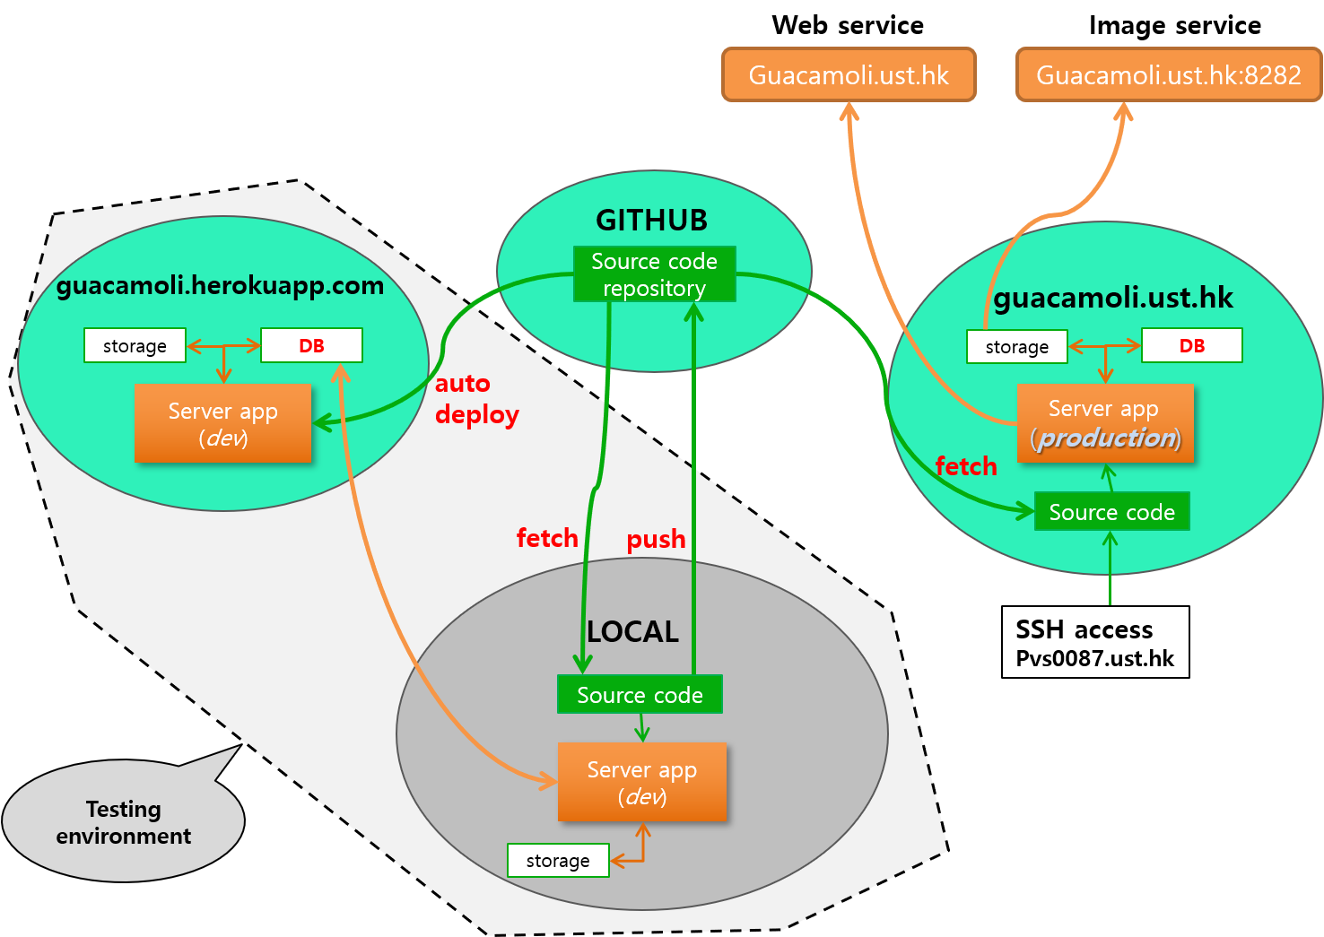

Slide 3
Testing on local machine
1. Run node app in local machine. (node server.js)
2. Navigate to “localhost:5000” in ur web browser
(app is connected to database on guacamoli.herokuapp.com)
Requisites:
node, npm
Optional:
Heroku toolbelt (To manage test DB on heroku)

Slide 4
Testing on Heroku
1. Push the code base to github
2. Navigate to “guacamoli.herokuapp.com”
Requisites:
None (Code is automatically deployed to heroku test server)

Slide 5
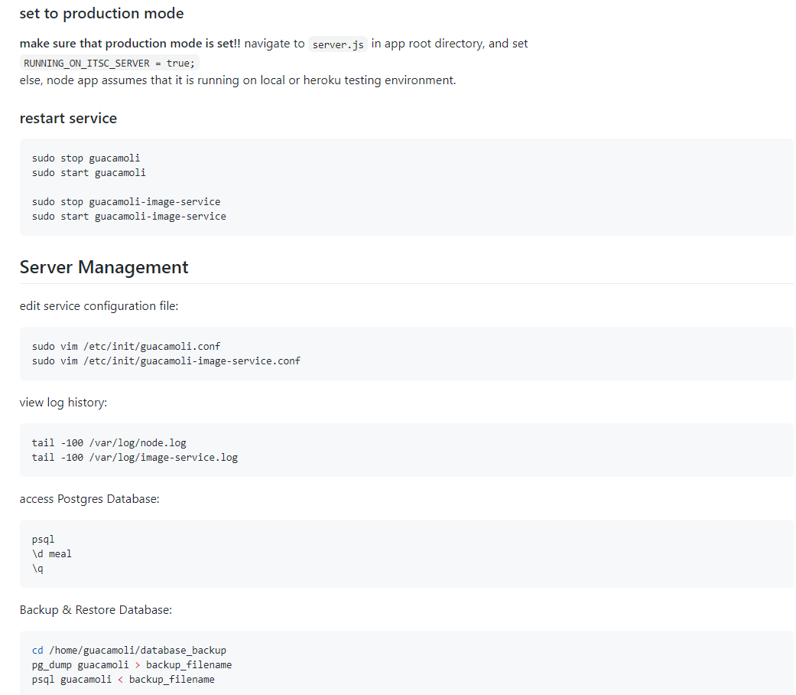
Deploying app
https://github.com/hjchoi95/guacamoli/blob/master/README.md

Slide 6
Issues
Image Storage problem: Images aren’t being deleted automatically (kind of a dangling pointer problem)
Need to clean up log file somehow.
Potential performance issue related to database design and operations.
Ranking API is apparently buggy.
Image name containing multiple “.”s can cause problems

Slide 7
To-do
Create User table
Create Rating API for users to rate meals
Blah
blahhh

